Slide 1
The Foundations: Logic and Proofs

Slide 2
Proofs
A proof is a valid argument that establishes the truth of a mathematical statement.
Ingredients:
hypotheses of the theorem
axioms assumed to be true
previously proven theorems
rules of inference
You get:
truth of the
statement
being proved

Slide 3
Usefulness
Computer Science
Verifying that computer programs are correct.
Establishing that operating systems are secure.
Making inferences in artificial intelligence.
Showing that system specifications are consistent.
Mathematics
Defining Formalism.
Providing specification in a common language.
Justification for the results.

Slide 4
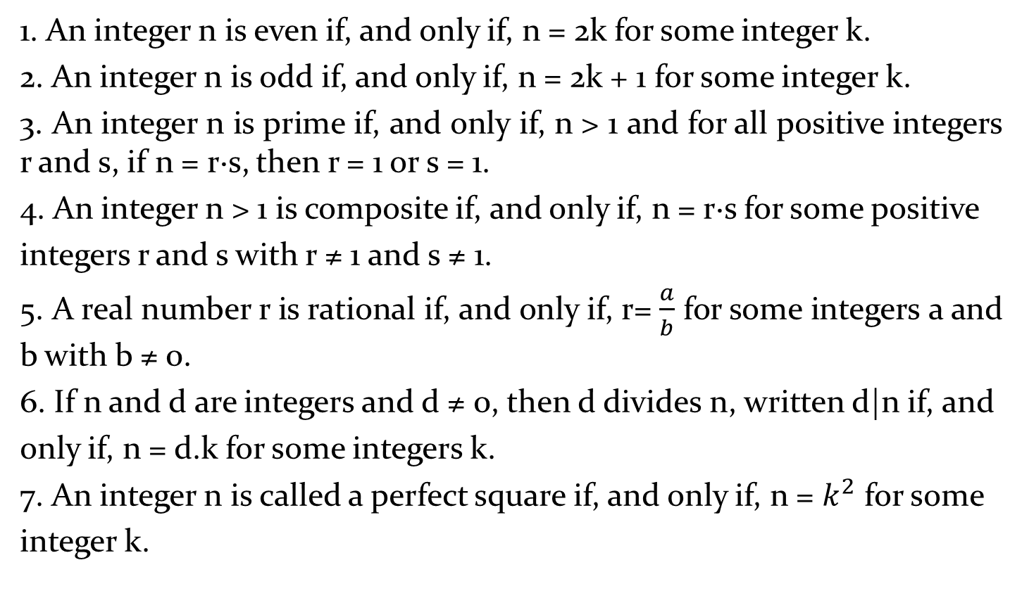
Definitions
1. An integer n is even if, and only if, n = 2k for some integer k.
2. An integer n is odd if, and only if, n = 2k + 1 for some integer k.
3. An integer n is prime if, and only if, n > 1 and for all positive integers r and s, if n = r·s, then r = 1 or s = 1.
4. An integer n > 1 is composite if, and only if, n = r·s for some positive
integers r and s with r ≠ 1 and s ≠ 1.
5. A real number r is rational if, and only if, r= $\frac{a}{b}$ for some integers a and b with b ≠ 0.
6. If n and d are integers and d ≠ 0, then d divides n, written d|n if, and
only if, n = d.k for some integers k.
7. An integer n is called a perfect square if, and only if, n = $k^{2}$ for some
integer k.

Slide 5
Types of Proofs
Proving conditional Statements
Direct Proofs
Indirect Proofs
Proof by Contraposition
Proofs by Contradiction
Proving Non-conditional Statements
Indirect Proofs
If-And-Only-If Proof
Constructive Versus Non-constructive Proofs
Existence Proofs; Existence and Uniqueness Proofs
Disproofs (Counterexample, Contradiction, Existence Statement)
Proofs Involving Sets
Mathematical Induction

Slide 6
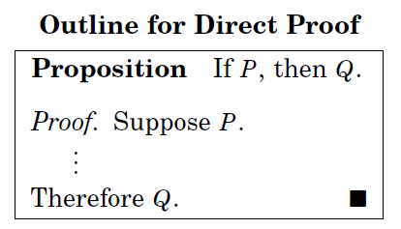
Direct Proofs
p →q
first step is the assumption that p is true
subsequent steps constructed using rules of inference.
final step showing that q must also be true
showing that if p is true,
then q must also be true,
so that the combination
p true and q false never occurs

Slide 7

Activity Time
Prove that the sum of two odd integers is even.

Slide 8
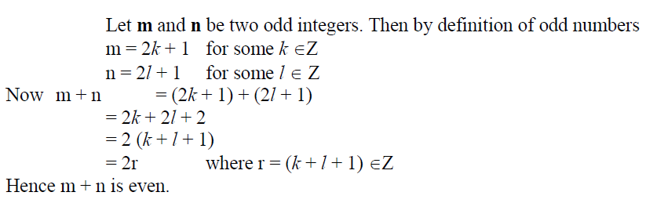
Prove that the sum of two odd integers is even.

Slide 9
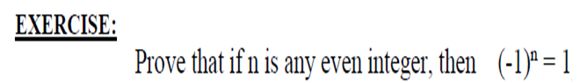
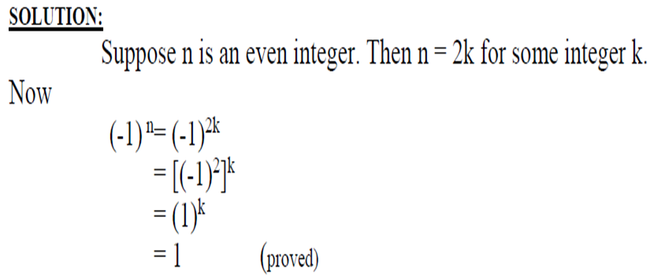

Slide 10
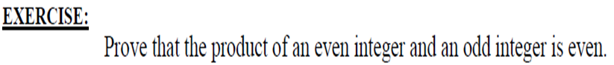
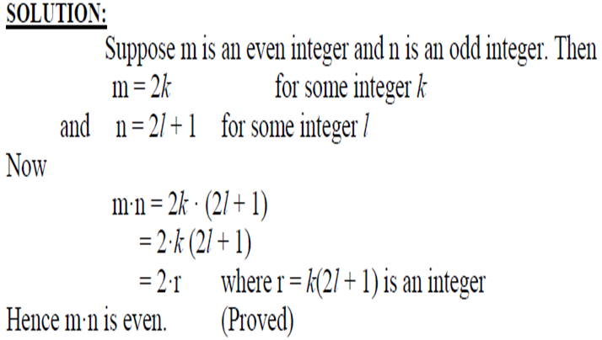

Slide 11
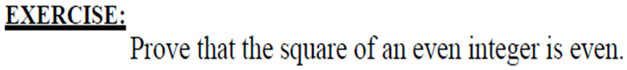
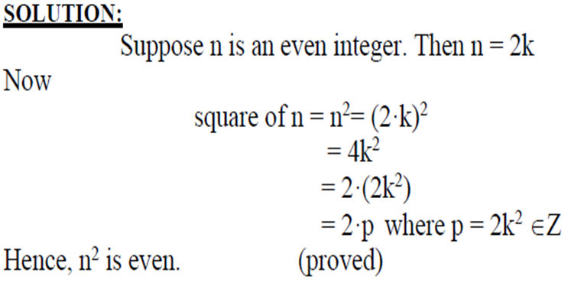

Slide 12
proved that if n is an odd integer, then n² is an odd integer
We assume that the hypothesis of this conditional statement is true, namely, we assume that n is odd.
By the definition of an odd integer, it follows that n = 2k + 1, where k is some integer.
Square both sides n² = (2k + 1)²
4k² + 4k + 1 = 2(2k² + 2k) + 1.
Consequently, we have proved that if n is an odd integer, then n² is an odd integer

Slide 13
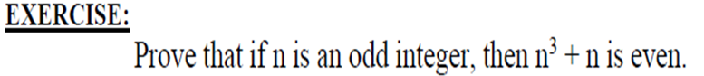
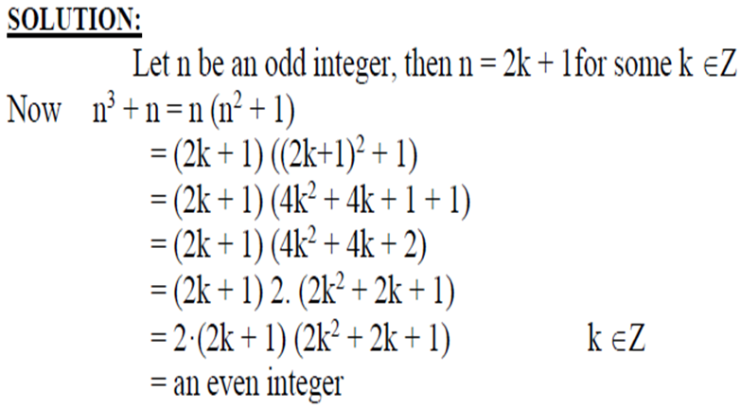

Slide 14
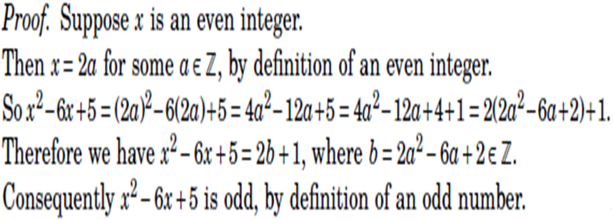

Slide 15
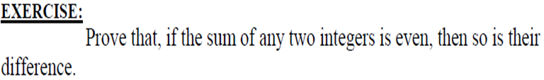
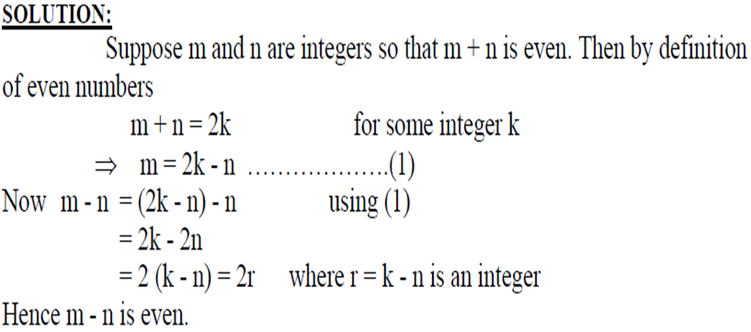

Slide 16
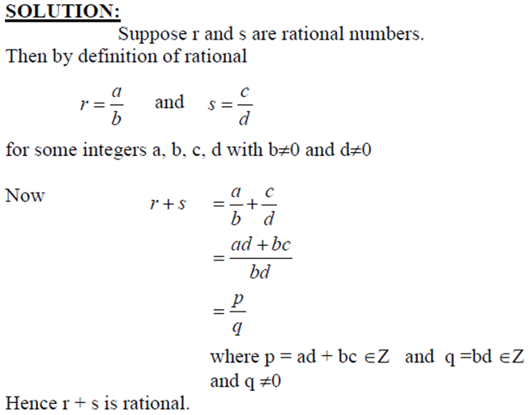

Slide 17
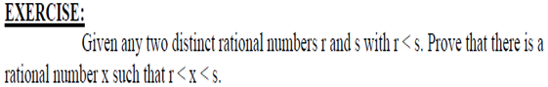
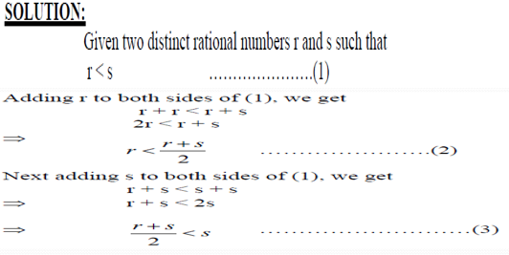

Slide 18
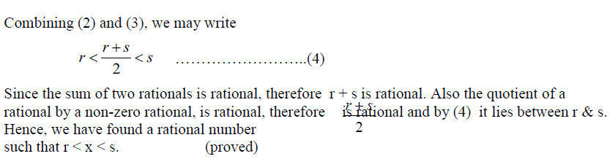

Slide 19
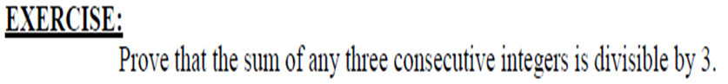
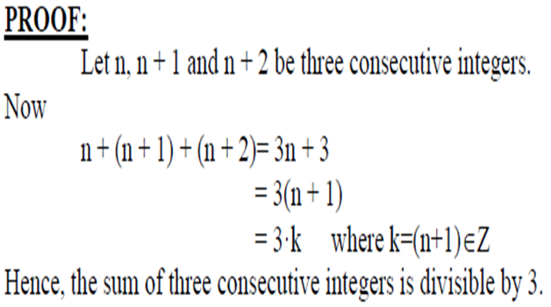

Slide 20
Activity Time
Give a direct proof that if m and n are both perfect squares, then nm is also a perfect square.

Slide 21
Proof
We assume that the hypothesis of this conditional statement is true, namely, we assume that m and n are both perfect squares.
By the definition of a perfect square, It follows that there are integers s and t such that m = s² and n = t².
Multiplying both m and n to get s²t².
Hence, mn = s²t² = (ss)(tt) = (st)(st) = (st)², using commutativity and associativity of multiplication.
By the definition of perfect square, it follows that mn is also a perfect square, because it is the square of st, which is an integer.
We have proved that if m and n are both perfect squares, then mn is also a perfect square.

Slide 22
Activity Time
Give a direct proof that if n is an integer and n is odd, then 3n + 2 is odd.

Slide 23
Indirect Proofs
Direct proof begin with the premises, continue with a sequence of deductions, and end with the conclusion.
Attempts at direct proofs often reach dead ends
Proofs that do not start with the premises and end with the conclusion, are called indirect proofs

Slide 24
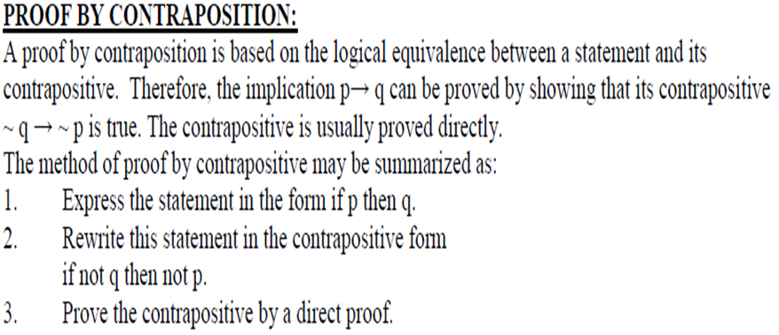
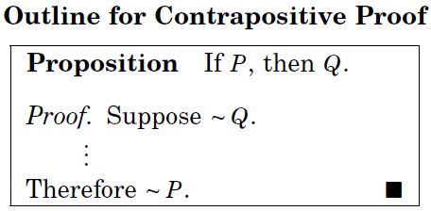

Slide 25
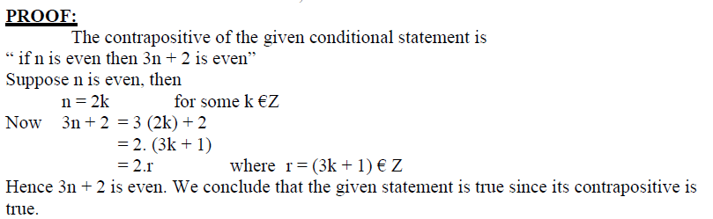
Prove that if n is an integer and 3n + 2 is odd, then n is odd.

Slide 26
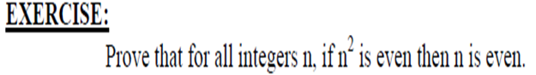
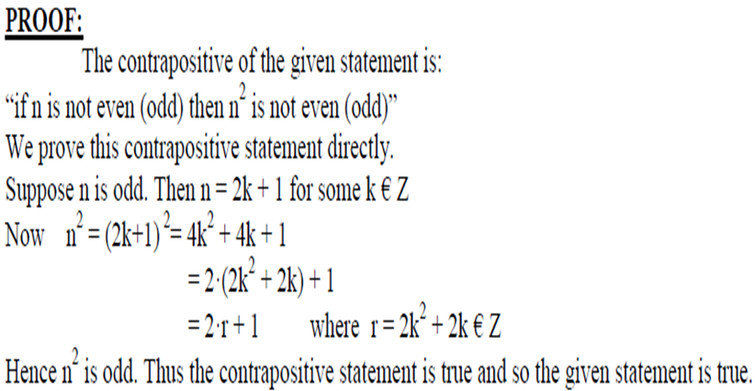

Slide 27
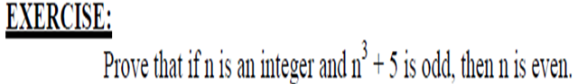
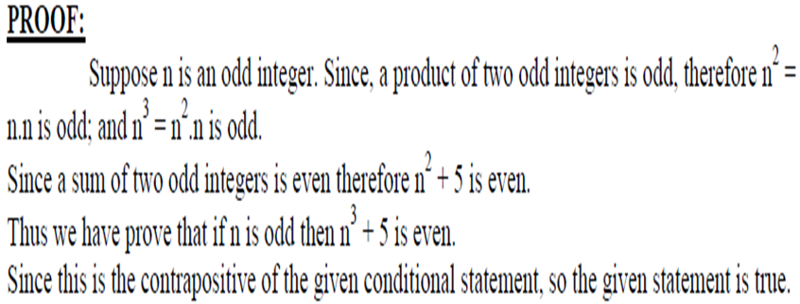

Slide 28
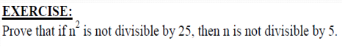
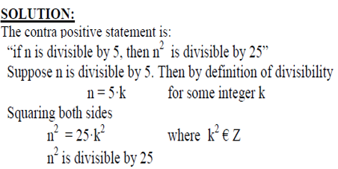

Slide 29
Proofs by Contradiction
A proof by contradiction is based on the fact that either a statement is true or it is false but not both. Hence the supposition, that the statement to be proved is false, leads logically to a contradiction, impossibility or absurdity, then the supposition must be false. Accordingly, the given statement must be true.
The method of proof by contradiction may be summarized as follows:
1. Suppose the statement to be proved is false.
2. Show that this supposition leads logically to a contradiction.
3. Conclude that the statement to be proved is true.

Slide 30
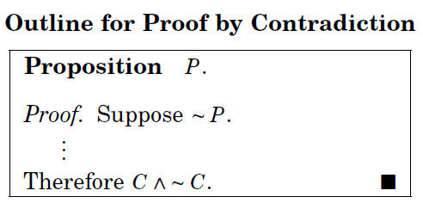
Basic Idea
Assume that the statement we want to prove is false, and then show that this assumption leads to nonsense!
We are then led to
conclude that we were
wrong to assume the
statement was false,
so the statement must be true.

Slide 31
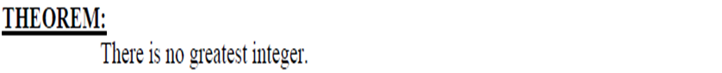
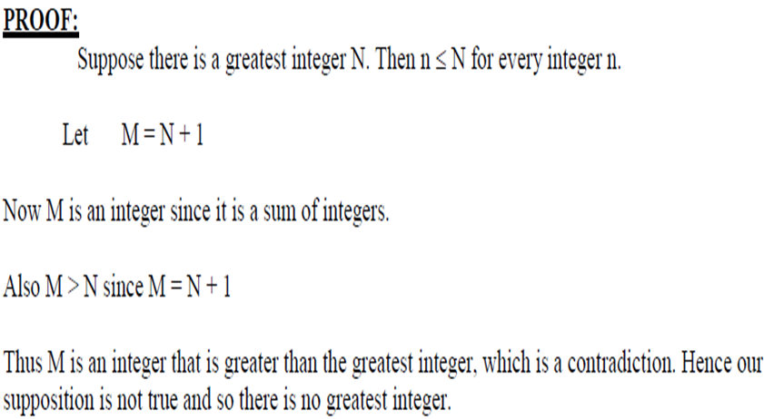

Slide 32
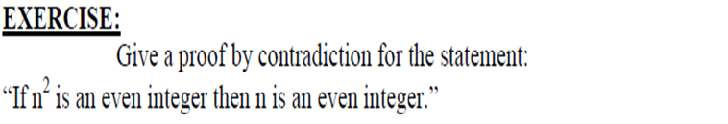
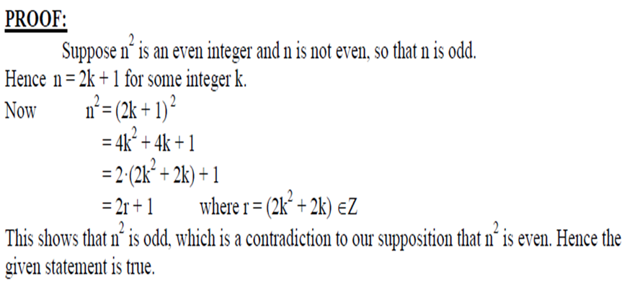

Slide 33
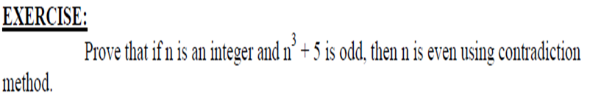
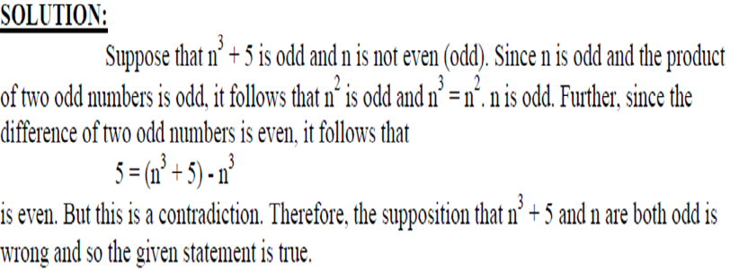

Slide 34
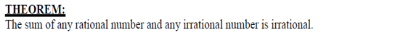
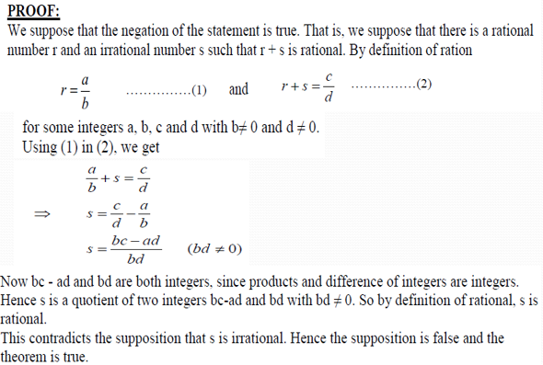

Slide 35
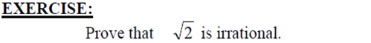
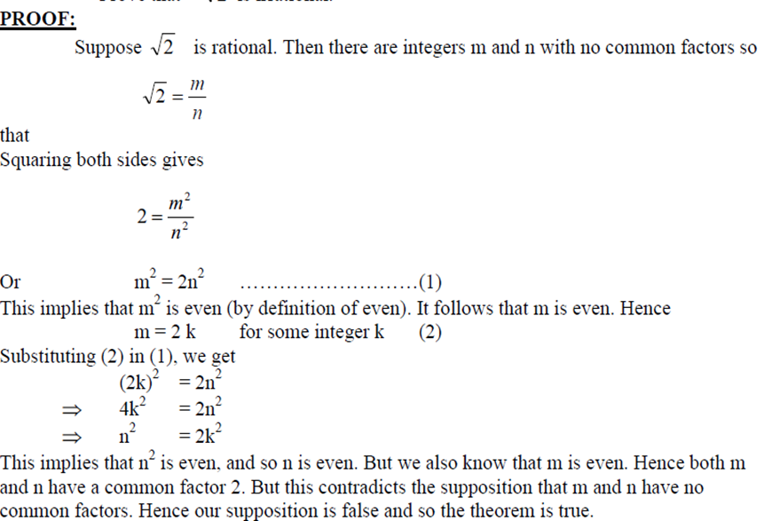

Slide 36
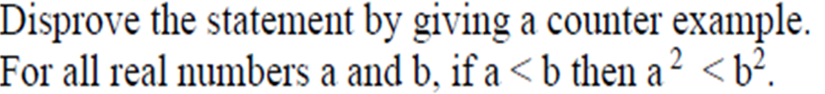
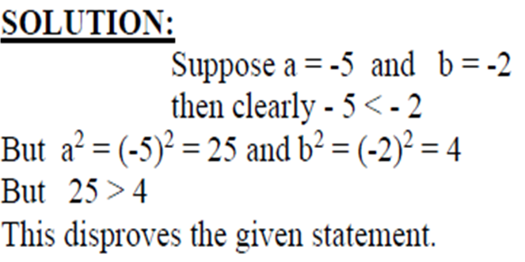
PROOF BY COUNTER EXAMPLE

Slide 37
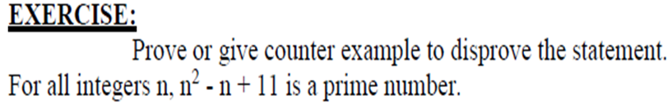
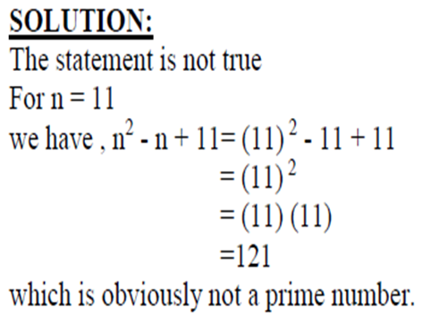

Slide 38
Mathematical Induction
Shoaib Raza

Slide 39
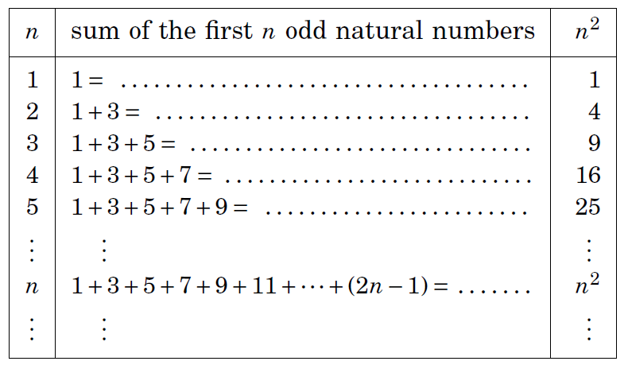
Conjecture: The sum of the first n odd natural numbers equals n².

Slide 40
An infinite ladder
Suppose that we have an infinite ladder, and we want to know whether we can reach every step on this ladder.
We know two things:
1. We can reach the first rung of the ladder.
2. If we can reach a particular rung of the ladder, then we can reach the next rung.

Slide 41
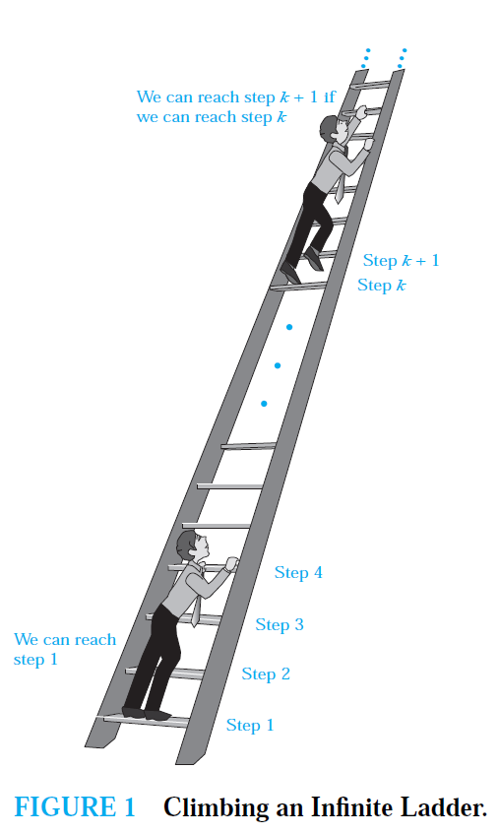

Slide 42
Mathematical Induction
Mathematical statements assert that a property is true for all positive integers.
Proofs using mathematical induction have two parts.
First, they show that the statement holds for the positive integer 1 (base case).
Second, they show that if the statement holds for a positive integer then it must also hold for the next larger integer. (inductive case)
The method can be extended to prove statements about more general well-founded structures, such as trees; this generalization, known as structural induction, is used in mathematical logic and computer science.

Slide 43
NOTE
It is extremely important to note that mathematical induction can be used only to prove results obtained in some other way.
It is not a tool for discovering formulae or theorems.
Mathematicians sometimes find proofs by mathematical induction unsatisfying because they do not provide insights as to why theorems are true.
You can prove a theorem by mathematical induction even if you do not have the slightest idea why it is true!

Slide 44
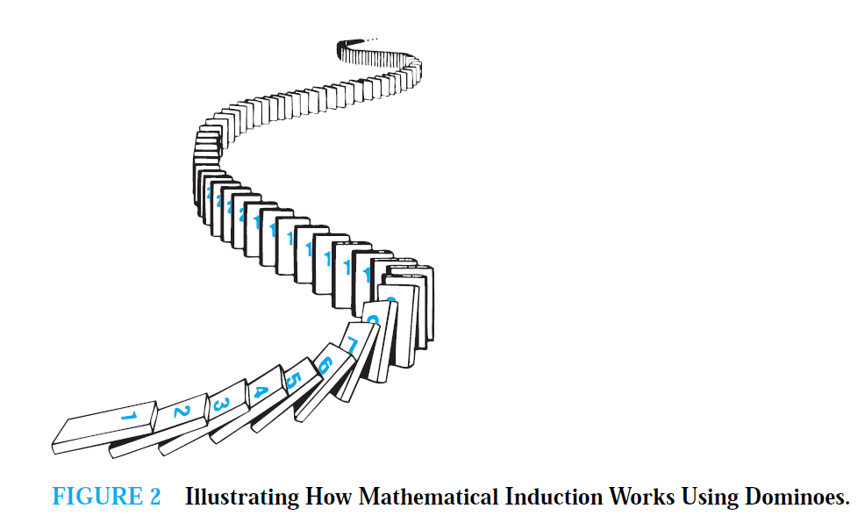

Slide 45
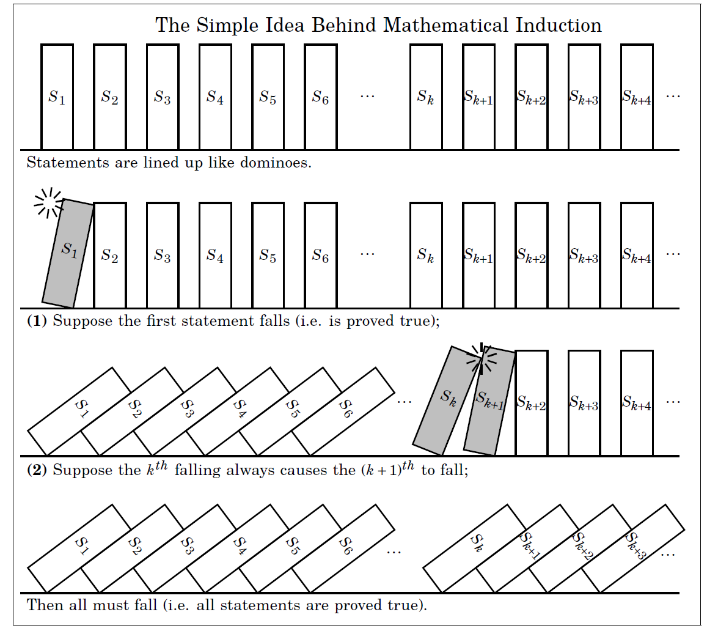

Slide 46
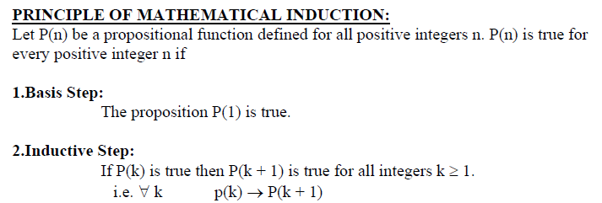

Slide 47
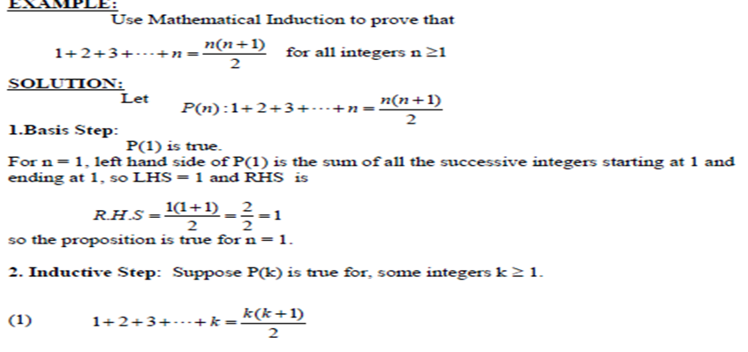

Slide 48



Slide 49


Slide 50


Slide 51
Counting
Chapter 6
Mr. Shoaib Raza

Slide 52
Chapter Summary
The Basics of Counting
The Pigeonhole Principle
Permutations and Combinations
Binomial Coefficients and Identities
Generalized Permutations and Combinations

Slide 53
Number Theory and Cryptography
Chapter 4

Slide 54
Chapter Motivation
Number theory is the part of mathematics devoted to the study of the integers and their properties.
Key ideas in number theory include divisibility and the primality of integers.
Number theory has long been studied because of the beauty of its ideas, its accessibility, and its wealth of open questions.
We’ll use many ideas developed in Chapter 1 about proof methods and proof strategy in our exploration of number theory.
Mathematicians have long considered number theory to be pure mathematics, but it has important applications to computer science and cryptography studied in Sections 4.5 and 4.6.

Slide 55
Chapter Summary
Divisibility and Modular Arithmetic
Primes and Greatest Common Divisors
Solving Congruencies
Applications of Congruencies
Cryptography

Slide 56
Divisibility and Modular Arithmetic
Section 4.1

Slide 57
Section Summary
Division
Division Algorithm
Modular Arithmetic

Slide 58
Division
Definition: If a and b are integers with a ≠ 0, then a divides b if there exists an integer c such that b = ac.
When a divides b we say that a is a factor or divisor of b and that b is a multiple of a.
The notation a | b denotes that a divides b.
If a | b, then b/a is an integer.
If a does not divide b, we write a ∤ b.
Example: Determine whether 3 | 7 and whether 3 | 12.

Slide 59
Properties of Divisibility
Theorem 1: Let a, b, and c be integers, where a ≠0.
If a | b and a | c, then a | (b + c);
If a | b, then a | bc for all integers c;
If a | b and b | c, then a | c.
Proof: (i) Suppose a | b and a | c, then it follows that there are integers s and t with b = as and c = at. Hence,
b + c = as + at = a(s + t). Hence, a | (b + c)
(Exercises 3 and 4 ask for proofs of parts (ii) and (iii).) Corollary: If a, b, and c be integers, where a ≠0, such that a | b and a | c, then a | mb + nc whenever m and n are integers.
Can you show how it follows easily from from (ii) and (i) of Theorem 1?

Slide 60
Division Algorithm
When an integer is divided by a positive integer, there is a quotient and a remainder. This is traditionally called the “Division Algorithm,” but is really a theorem.
Division Algorithm: If a is an integer and d a positive integer, then there are unique integers q and r, with 0 ≤ r < d, such that a = dq + r (proved in Section 5.2).
d is called the divisor.
a is called the dividend.
q is called the quotient.
r is called the remainder.
Examples:
What are the quotient and remainder when 101 is divided by 11?
Solution: The quotient when 101 is divided by 11 is 9 = 101 div 11, and the remainder is 2 = 101 mod 11.
What are the quotient and remainder when −11 is divided by 3?
Solution: The quotient when −11 is divided by 3 is −4 = −11 div 3, and the remainder is 1 = −11 mod 3.
Definitions of Functions div and mod
q = a div d
r = a mod d

Slide 61
Congruence Relation
Definition: If a and b are integers and m is a positive integer, then a is congruent to b modulo m if m divides a – b.
The notation a ≡ b (mod m) says that a is congruent to b modulo m.
We say that a ≡ b (mod m) is a congruence and that m is its modulus.
Two integers are congruent mod m if and only if they have the same remainder when divided by m.
If a is not congruent to b modulo m, we write
a ≢ b (mod m)
Example: Determine whether 17 is congruent to 5 modulo 6 and whether 24 and 14 are congruent modulo 6.
Solution:
17 ≡ 5 (mod 6) because 6 divides 17 − 5 = 12.
24 ≢ 14 (mod 6) since 6 divides 24 − 14 = 10 is not divisible by 6.

Slide 62
More on Congruences
Theorem 4: Let m be a positive integer. The integers a and b are congruent modulo m if and only if there is an integer k such that a = b + km.
Proof:
If a ≡ b (mod m), then (by the definition of congruence) m | a – b. Hence, there is an integer k such that a – b = km and equivalently a = b + km.
Conversely, if there is an integer k such that a = b + km, then km = a – b. Hence, m | a – b and a ≡ b (mod m).

Slide 63
The Relationship between (mod m) and mod m Notations
The use of “mod” in a ≡ b (mod m) and a mod m = b are different.
a ≡ b (mod m) is a relation on the set of integers.
In a mod m = b, the notation mod denotes a function.
The relationship between these notations is made clear in this theorem.
Theorem 3: Let a and b be integers, and let m be a positive integer. Then a ≡ b (mod m) if and only if a mod m = b mod m. (Proof in the exercises)

Slide 64
Congruencies of Sums and Products
Let m be a positive integer. If a ≡ b (mod m) and c ≡ d (mod m), then
a + c ≡ b + d (mod m) and ac ≡ bd (mod m)
Example: Because 7 ≡ 2 (mod 5) and 11 ≡ 1 (mod 5) , it follows from Theorem 5 that
18 = 7 + 11 ≡ 2 + 1 = 3 (mod 5)
77 = 7 11 ≡ 2 * 1 = 2 (mod 5)

Slide 65
Algebraic Manipulation of Congruencies
Multiplying both sides of a valid congruence by an integer preserves validity.
If a ≡ b (mod m) holds then c∙a ≡ c∙b (mod m), where c is any integer, holds by Theorem 5 with d = c.
Adding an integer to both sides of a valid congruence preserves validity.
If a ≡ b (mod m) holds then c + a ≡ c + b (mod m), where c is any integer, holds by Theorem 5 with d = c.
Dividing a congruence by an integer does not always produce a valid congruence.
Example: The congruence 14≡ 8 (mod 6) holds. But dividing both sides by 2 does not produce a valid congruence since 14/2 = 7 and 8/2 = 4, but 7≢4 (mod 6).

Slide 66
Computing the mod m Function of Products and Sums
We use the following corollary to Theorem 5 to compute the remainder of the product or sum of two integers when divided by m from the remainders when each is divided by m.
Corollary: Let m be a positive integer and let a and b be integers. Then
(a + b) (mod m) = ((a mod m) + (b mod m)) mod m
and
ab mod m = ((a mod m) (b mod m)) mod m.
(proof in text)

Slide 67
Applications of Congruences

Slide 68
Section Summary
Hashing Functions
Pseudorandom Numbers
Check Digits

Slide 69
Hashing Functions
Definition: A hashing function h assigns memory location h(k) to the record that has k as its key.
A common hashing function is h(k) = k mod m, where m is the number of memory locations.
Because this hashing function is onto, all memory locations are possible.
Example: Let h(k) = k mod 111. This hashing function assigns the records of customers with social security numbers as keys to memory locations in the following manner:
h(064212848) = 064212848 mod 111 = 14
h(037149212) = 037149212 mod 111 = 65
h(107405723) = 107405723 mod 111 = 14, but since location 14 is already occupied, the record is assigned to the next available position, which is 15.
The hashing function is not one-to-one as there are many more possible keys than memory locations. When more than one record is assigned to the same location, we say a collision occurs. Here a collision has been resolved by assigning the record to the first free location.
For collision resolution, we can use a linear probing function:
h(k,i) = (h(k) + i) mod m, where i runs from 0 to m − 1.
There are many other methods of handling with collisions. You may cover these in a
later CS course.

Slide 70
Pseudorandom Numbers
Randomly chosen numbers are needed for many purposes, including computer simulations.
Pseudorandom numbers are not truly random since they are generated by systematic methods.
The linear congruential method is one commonly used procedure for generating pseudorandom numbers.
Four integers are needed: the modulus m, the multiplier a, the increment c, and seed x₀, with 2 ≤ a < m, 0 ≤ c < m, 0 ≤ x₀ < m.
We generate a sequence of pseudorandom numbers {x_{n}}, with 0 ≤ x_{n} < m for all n, by successively using the recursively defined function
(an example of a recursive definition, discussed in Section 5.3)
If psudorandom numbers between 0 and 1 are needed, then the generated numbers are divided by the modulus, x_{n} /m.
x_{n+1} = (ax_{n} + c) mod m.

Slide 71
Pseudorandom Numbers
Example: Find the sequence of pseudorandom numbers generated by the linear congruential method with modulus m = 9, multiplier a = 7, increment c = 4, and seed x₀ = 3.
Solution: Compute the terms of the sequence by successively using the congruence x_{n+1} = (7x_{n} + 4) mod 9, with x₀ = 3.
x₁ = 7x₀ + 4 mod 9 = 7∙3 + 4 mod 9 = 25 mod 9 = 7,
x₂ = 7x₁ + 4 mod 9 = 7∙7 + 4 mod 9 = 53 mod 9 = 8,
x₃ = 7x₂ + 4 mod 9 = 7∙8 + 4 mod 9 = 60 mod 9 = 6,
x₄ = 7x₃ + 4 mod 9 = 7∙6 + 4 mod 9 = 46 mod 9 = 1,
x₅ = 7x₄ + 4 mod 9 = 7∙1 + 4 mod 9 = 11 mod 9 = 2,
x₆ = 7x₅ + 4 mod 9 = 7∙2 + 4 mod 9 = 18 mod 9 = 0,
x₇ = 7x₆ + 4 mod 9 = 7∙0 + 4 mod 9 = 4 mod 9 = 4,
x₈ = 7x₇ + 4 mod 9 = 7∙4 + 4 mod 9 = 32 mod 9 = 5,
x₉ = 7x₈ + 4 mod 9 = 7∙5 + 4 mod 9 = 39 mod 9 = 3.
The sequence generated is 3,7,8,6,1,2,0,4,5,3,7,8,6,1,2,0,4,5,3,…
It repeats after generating 9 terms.
Commonly, computers use a linear congruential generator with increment c = 0. This is called a pure multiplicative generator. Such a generator with modulus 2³¹ − 1 and multiplier 7⁵ = 16,807 generates 2³¹ − 2 numbers before repeating.

Slide 72
Check Digits: UPCs
A common method of detecting errors in strings of digits is to add an extra digit at the end, which is evaluated using a function. If the final digit is not correct, then the string is assumed not to be correct.
Example: Retail products are identified by their Universal Product Codes (UPCs). Usually these have 12 decimal digits, the last one being the check digit. The check digit is determined by the congruence:
3x₁ + x₂ + 3x₃ + x₄ + 3x₅ + x₆ + 3x₇ + x₈ + 3x₉ + x₁₀ + 3x₁₁ + x₁₂ ≡ 0 (mod 10).
Suppose that the first 11 digits of the UPC are 79357343104. What is the check digit?
Is 041331021641 a valid UPC?
Solution:
3∙7 + 9 + 3∙3 + 5 + 3∙7 + 3 + 3∙4 + 3 + 3∙1 + 0 + 3∙4 + x₁₂ ≡ 0 (mod 10)
21 + 9 + 9 + 5 + 21 + 3 + 12+ 3 + 3 + 0 + 12 + x₁₂ ≡ 0 (mod 10)
98 + x₁₂ ≡ 0 (mod 10)
x₁₂ ≡ 0 (mod 10) So, the check digit is 2.
3∙0 + 4 + 3∙1 + 3 + 3∙3 + 1 + 3∙0 + 2 + 3∙1 + 6 + 3∙4 + 1 ≡ 0 (mod 10)
0 + 4 + 3 + 3 + 9 + 1 + 0+ 2 + 3 + 6 + 12 + 1 = 44 ≡ 4 ≢ (mod 10)
Hence, 041331021641 is not a valid UPC.

Slide 73


Check Digits:ISBNs
Books are identified by an International Standard Book Number (ISBN-10), a 10 digit code. The first 9 digits identify the language, the publisher, and the book. The tenth digit is a check digit, which is determined by the following congruence
The validity of an ISBN-10 number can be evaluated with the equivalent
Suppose that the first 9 digits of the ISBN-10 are 007288008. What is the check digit?
Is 084930149X a valid ISBN10?
Solution:
a. X₁₀ ≡ 1∙0 + 2∙0 + 3∙7 + 4∙2 + 5∙8 + 6∙8 + 7∙ 0 + 8∙0 + 9∙8 (mod 11).
X₁₀ ≡ 0 + 0 + 21 + 8 + 40 + 48 + 0 + 0 + 72 (mod 11).
X₁₀ ≡ 189 ≡ 2 (mod 11). Hence, X₁₀ = 2.
b. 1∙0 + 2∙8 + 3∙4 + 4∙9 + 5∙3 + 6∙0 + 7∙ 1 + 8∙4 + 9∙9 + 10∙10 =
0 + 16 + 12 + 36 + 15 + 0 + 7 + 32 + 81 + 100 = 299 ≡ 2 ≢ 0 (mod 11)
Hence, 084930149X is not a valid ISBN-10.
A single error is an error in one digit of an identification number and a transposition error is the accidental interchanging of two digits. Both of these kinds of errors can be detected by the check digit for ISBN-10. (see text for more details)
X is used for the digit 10.

Slide 74
Arithmetic Modulo m
Definitions: Let Z_{m} be the set of nonnegative integers less than m: {0,1, …., m−1}
The operation +_{m} is defined as a +_{m} b = (a + b) mod m. This is addition modulo m.
The operation ∙_{m} is defined as a ∙_{m} b = (a . b) mod m. This is multiplication modulo m.
Using these operations is said to be doing arithmetic modulo m.
Example: Find 7 +₁₁ 9 and 7 ∙₁₁ 9.
Solution: Using the definitions above:
7 +₁₁ 9 = (7 + 9) mod 11 = 16 mod 11 = 5
7 ∙₁₁ 9 = (7 ∙ 9) mod 11 = 63 mod 11 = 8

Slide 75
Arithmetic Modulo m
The operations +_{m} and ∙_{m} satisfy many of the same properties as ordinary addition and multiplication.
Closure: If a and b belong to Z_{m} , then a +_{m} b and a ∙_{m} b belong to Z_{m} .
Associativity: If a, b, and c belong to Z_{m} , then (a +_{m} b) +_{m} c = a +_{m} (b +_{m} c) and (a ∙_{m} b) ∙_{m} c = a ∙_{m} (b ∙_{m} c).
Commutativity: If a and b belong to Z_{m} , then a +_{m} b = b +_{m} a and a ∙_{m} b = b ∙_{m} a.
Identity elements: The elements 0 and 1 are identity elements for addition and multiplication modulo m, respectively.
If a belongs to Z_{m} , then a +_{m} 0 = a and a ∙_{m} 1 = a.
continued →

Slide 76
Arithmetic Modulo m
Additive inverses: If a≠ 0 belongs to Z_{m} , then m− a is the additive inverse of a modulo m and 0 is its own additive inverse.
a +_{m} (m− a ) = 0 and 0 +_{m} 0 = 0
Distributivity: If a, b, and c belong to Z_{m} , then
a ∙_{m} (b +_{m} c) = (a ∙_{m} b) +_{m} (a ∙_{m} c) and (a +_{m} b) ∙_{m} c = (a ∙_{m} c) +_{m} (b ∙_{m} c).
Exercises 42-44 ask for proofs of these properties.
Multiplicatative inverses have not been included since they do not always exist. For example, there is no multiplicative inverse of 2 modulo 6.
(optional) Using the terminology of abstract algebra, Z_{m} with +_{m} is a commutative group and Z_{m} with +_{m} and ∙_{m} is a commutative ring.

Slide 77
Primes and Greatest Common Divisors
Section 4.3

Slide 78
Section Summary
Prime Numbers and their Properties
Greatest Common Divisors and Least Common Multiples
The Euclidian Algorithm
gcds as Linear Combinations

Slide 79
Primes
Definition: A positive integer p greater than 1 is called prime if the only positive factors of p are 1 and p. A positive integer that is greater than 1 and is not prime is called composite.
Example: The integer 7 is prime because its only positive factors are 1 and 7, but 9 is composite because it is divisible by 3.

Slide 80
The Fundamental Theorem of Arithmetic
Theorem: Every positive integer greater than 1 can be written uniquely as a prime or as the product of two or more primes where the prime factors are written in order of non decreasing size.
Examples:
100 = 2 ∙ 2 ∙ 5 ∙ 5 = 2² ∙ 5²
641 = 641
999 = 3 ∙ 3 ∙ 3 ∙ 37 = 3³ ∙ 37
1024 = 2 ∙ 2 ∙ 2 ∙ 2 ∙ 2 ∙ 2 ∙ 2 ∙ 2 ∙ 2 ∙ 2 = 2¹⁰

Slide 81

The Sieve of Erastosthenes
If an integer n is a composite integer, then it has a prime divisor less than or equal to √n.
To see this, note that if n = ab, then a ≤ √n or b ≤√n.
Trial division, a very inefficient method of determining if a number n is prime, is to try every integer i ≤√n and see if n is divisible by i.

Slide 82

The Sieve of Erastosthenes
Erastothenes
(276-194 B.C.)
The Sieve of Erastosthenes can be used to find all primes not exceeding a specified positive integer. For example, begin with the list of integers between 1 and 100.
Delete all the integers, other than 2, divisible by 2.
Delete all the integers, other than 3, divisible by 3.
Next, delete all the integers, other than 5, divisible by 5.
Next, delete all the integers, other than 7, divisible by 7.
Since all the remaining integers are not divisible by any of the previous integers, other than 1, the primes are:
{2,3,5,7,11,13,17,19,23,29,31,37,41,43,47,53,59,61,67,71,73,79,83,89, 97}
continued →

Slide 83

Mersenne Primes
Marin Mersenne
(1588-1648)
Definition: Prime numbers of the form 2^{p} − 1 , where p is prime, are called Mersenne primes.
2² − 1 = 3, 2³ − 1 = 7, 2⁵ − 1 = 37 , and 2⁷ − 1 = 127 are Mersenne primes.
2¹¹ − 1 = 2047 is not a Mersenne prime since 2047 = 23∙89.
There is an efficient test for determining if 2^{p} − 1 is prime.
The largest known prime numbers are Mersenne primes.
As of mid 2011, 47 Mersenne primes were known, the largest is 2^{43,112,609} − 1, which has nearly 13 million decimal digits.
The Great Internet Mersenne Prime Search (GIMPS) is a distributed computing project to search for new Mersenne Primes.
http://www.mersenne.org/

Slide 84
Greatest Common Divisor
Definition: Let a and b be integers, not both zero. The largest integer d such that d | a and also d | b is called the greatest common divisor of a and b. The greatest common divisor of a and b is denoted by gcd(a,b).
One can find greatest common divisors of small numbers by inspection.
Example: What is the greatest common divisor of 24 and 36?
Solution: gcd(24,36) = 12
Example: What is the greatest common divisor of 17 and 22?
Solution: gcd(17,22) = 1

Slide 85
Greatest Common Divisor
Definition: The integers a and b are relatively prime if their greatest common divisor is 1.
Example: 17 and 22
Definition: The integers a₁, a₂, …, a_{n} are pairwise relatively prime if gcd(a_{i}, a_{j})= 1 whenever 1 ≤ i<j ≤n.
Example: Determine whether the integers 10, 17 and 21 are pairwise relatively prime.
Solution: Because gcd(10,17) = 1, gcd(10,21) = 1, and gcd(17,21) = 1, 10, 17, and 21 are pairwise relatively prime.
Example: Determine whether the integers 10, 19, and 24 are pairwise relatively prime.
Solution: Because gcd(10,24) = 2, 10, 19, and 24 are not pairwise relatively prime.

Slide 86


Finding the Greatest Common Divisor Using Prime Factorizations
Suppose the prime factorizations of a and b are:
where each exponent is a nonnegative integer, and where all primes occurring in either prime factorization are included in both. Then:
This formula is valid since the integer on the right (of the equals sign) divides both a and b. No larger integer can divide both a and b.
Example: 120 = 2³ ∙3 ∙5 500 = 2² ∙5³
gcd(120,500) = 2^{min(3,2)} ∙3^{min(1,0)} ∙5^{min(1,3)} = 2² ∙3⁰ ∙5¹ = 20
Finding the gcd of two positive integers using their prime factorizations is not efficient because there is no efficient algorithm for finding the prime factorization of a positive integer.

Slide 87
Least Common Multiple
Definition: The least common multiple of the positive integers a and b is the smallest positive integer that is divisible by both a and b. It is denoted by lcm(a,b).
The least common multiple can also be computed from the prime factorizations.
This number is divided by both a and b and no smaller number is divided by a and b.
Example: lcm(2³3⁵7², 2⁴3³) = 2^{max(3,4)} 3^{max(5,3)} 7^{max(2,0)} = 2⁴ 3⁵ 7²
The greatest common divisor and the least common multiple of two integers are related by:
Theorem 5: Let a and b be positive integers. Then
ab = gcd(a,b) ∙lcm(a,b)
(proof is Exercise 31)

Slide 88

Euclidean Algorithm
Euclid
(325 B.C.E. – 265 B.C.E.)
The Euclidian algorithm is an efficient method for computing the greatest common divisor of two integers. It is based on the idea that gcd(a,b) is equal to gcd(a,c) when a > b and c is the remainder when a is divided by b.
Example: Find gcd(91, 287):
287 = 91 ∙ 3 + 14
91 = 14 ∙ 6 + 7
14 = 7 ∙ 2 + 0
gcd(287, 91) = gcd(91, 14) = gcd(14, 7) = 7
Divide 287 by 91
Divide 91 by 14
Divide 14 by 7
Stopping condition
continued →

Slide 89
Euclidean Algorithm
The Euclidean algorithm expressed in pseudocode is:
In Section 5.3, we’ll see that the time complexity of the algorithm is O(log b), where a > b.
procedure gcd(a, b: positive integers)
x := a
x := b
while y ≠ 0
r := x mod y
x := y
y := r
return x {gcd(a,b) is x}

Slide 90

gcds as Linear Combinations
Étienne Bézout
(1730-1783)
Bézout’s Theorem: If a and b are positive integers, then there exist integers s and t such that gcd(a,b) = sa + tb.
Definition: If a and b are positive integers, then integers s and t such that gcd(a,b) = sa + tb are called Bézout coefficients of a and b. The equation gcd(a,b) = sa + tb is called Bézout’s identity.
By Bézout’s Theorem, the gcd of integers a and b can be expressed in the form sa + tb where s and t are integers. This is a linear combination with integer coefficients of a and b.
gcd(6,14) = (−2)∙6 + 1∙14

Slide 91
Finding gcds as Linear Combinations
Example: Express gcd(252,198) = 18 as a linear combination of 252 and 198.
Solution: First use the Euclidean algorithm to show gcd(252,198) = 18
252 = 1∙198 + 54
198 = 3 ∙54 + 36
54 = 1 ∙36 + 18
36 = 2 ∙18
Now working backwards, from iii and i above
18 = 54 − 1 ∙36
36 = 198 − 3 ∙54
Substituting the 2nd equation into the 1st yields:
18 = 54 − 1 ∙(198 − 3 ∙54 )= 4 ∙54 − 1 ∙198
Substituting 54 = 252 − 1 ∙198 (from i)) yields:
18 = 4 ∙(252 − 1 ∙198) − 1 ∙198 = 4 ∙252 − 5 ∙198
This method illustrated above is a two pass method. It first uses the Euclidian algorithm to find the gcd and then works backwards to express the gcd as a linear combination of the original two integers. A one pass method, called the extended Euclidean algorithm, is developed in the exercises.

Slide 92
Dividing Congruencies by an Integer
Dividing both sides of a valid congruence by an integer does not always produce a valid congruence (see Section 4.1).
But dividing by an integer relatively prime to the modulus does produce a valid congruence:
Theorem 7: Let m be a positive integer and let a, b, and c be integers. If ac ≡ bc (mod m) and gcd(c,m) = 1, then a ≡ b (mod m).
Proof: Since ac ≡ bc (mod m), m | ac − bc = c(a − b) by Lemma 2 and the fact that gcd(c,m) = 1, it follows that m | a − b. Hence, a ≡ b (mod m).

Slide 93
Solving Congruencies
Section 4.4

Slide 94
Section Summary
Linear Congruencies
The Chinese Remainder Theorem
Fermat’s Little Theorem
Pseudo primes

Slide 95
Linear Congruencies
Definition: A congruence of the form
ax ≡ b( mod m),
where m is a positive integer, a and b are integers, and x is a variable, is called a linear congruence.
The solutions to a linear congruence ax≡ b( mod m) are all integers x that satisfy the congruence.
Definition: An integer ā such that āa ≡ 1( mod m) is said to be an inverse of a modulo m.
Example: 5 is an inverse of 3 modulo 7 since 5∙3 = 15 ≡ 1(mod 7)
One method of solving linear congruencies makes use of an inverse ā, if it exists. Although we can not divide both sides of the congruence by a, we can multiply by ā to solve for x.

Slide 96
Inverse of a modulo m
The following theorem guarantees that an inverse of a modulo m exists whenever a and m are relatively prime. Two integers a and b are relatively prime when gcd(a,b) = 1.
Theorem 1: If a and m are relatively prime integers and m > 1, then an inverse of a modulo m exists. Furthermore, this inverse is unique modulo m. (This means that there is a unique positive integer ā less than m that is an inverse of a modulo m and every other inverse of a modulo m is congruent to ā modulo m.)
Proof: Since gcd(a,m) = 1, by Theorem 6 of Section 4.3, there are integers s and t such that sa + tm = 1.
Hence, sa + tm ≡ 1 ( mod m).
Since tm ≡ 0 ( mod m), it follows that sa ≡ 1 ( mod m)
Consequently, s is an inverse of a modulo m.
The uniqueness of the inverse is Exercise 7.

Slide 97
Finding Inverses
The Euclidean algorithm and Bézout coefficients gives us a systematic approaches to finding inverses.
Example: Find an inverse of 3 modulo 7.
Solution: Because gcd(3,7) = 1, by Theorem 1, an inverse of 3 modulo 7 exists.
Using the Euclidian algorithm: 7 = 2∙3 + 1.
From this equation, we get −2∙3 + 1∙7 = 1, and see that −2 and 1 are Bézout coefficients of 3 and 7.
Hence, −2 is an inverse of 3 modulo 7.
Also every integer congruent to −2 modulo 7 is an inverse of 3 modulo 7, i.e., 5, −9, 12, etc.

Slide 98
Finding Inverses
Example: Find an inverse of 101 modulo 4620.
Solution: First use the Euclidian algorithm to show that gcd(101,4620) = 1.
Working Backwards:
4620 = 45∙101 + 75
101 = 1∙75 + 26
75 = 2∙26 + 23
26 = 1∙23 + 3
23 = 7∙3 + 2
3 = 1∙2 + 1
2 = 2∙1
1 = 3 − 1∙2
1 = 3 − 1∙(23 − 7∙3) = − 1 ∙23 + 8∙3
1 = −1∙23 + 8∙(26 − 1∙23) = 8∙26 − 9 ∙23
1 = 8∙26 − 9 ∙(75 − 2∙26 )= 26∙26 − 9 ∙75
1 = 26∙(101 − 1∙75) − 9 ∙75
= 26∙101 − 35 ∙75
1 = 26∙101 − 35 ∙(42620 − 45∙101)
= − 35 ∙42620 + 1601∙101
Since the last nonzero
remainder is 1,
gcd(101,4260) = 1
Bézout coefficients : − 35 and 1601
1601 is an inverse of 101 modulo 42620

Slide 99
Using Inverses to Solve Congruences
We can solve the congruence ax≡ b( mod m) by multiplying both sides by ā.
Example: What are the solutions of the congruence 3x≡ 4( mod 7).
Solution: We found that −2 is an inverse of 3 modulo 7 (two slides back). We multiply both sides of the congruence by −2 giving
−2 ∙ 3x ≡ −2 ∙ 4(mod 7).
Because −6 ≡ 1 (mod 7) and −8 ≡ 6 (mod 7), it follows that if x is a solution, then x ≡ −8 ≡ 6 (mod 7)
We need to determine if every x with x ≡ 6 (mod 7) is a solution. Assume that x ≡ 6 (mod 7). By Theorem 5 of Section 4.1, it follows that 3x ≡ 3 ∙ 6 = 18 ≡ 4( mod 7) which shows that all such x satisfy the congruence.
The solutions are the integers x such that x ≡ 6 (mod 7), namely, 6,13,20 … and −1, − 8, − 15,…

Slide 100
The Chinese Remainder Theorem
Theorem 2: (The Chinese Remainder Theorem) Let m₁,m₂,…,m_{n} be pairwise relatively prime positive integers greater than one and a₁,a₂,…,a_{n} arbitrary integers. Then the system
x ≡ a₁ ( mod m₁)
x ≡ a₂ ( mod m₂)
∙
∙
∙
x ≡ a_{n} ( mod m_{n})
has a unique solution modulo m = m₁m₂ ∙ ∙ ∙ m_{n}.
(That is, there is a solution x with 0 ≤ x <m and all other solutions are congruent modulo m to this solution.)
Proof: We’ll show that a solution exists by describing a way to construct the solution. Showing that the solution is unique modulo m is Exercise 30.
continued →

Slide 101
The Chinese Remainder Theorem
To construct a solution first let M_{k}=m/m_{k} for k = 1,2,…,n and m = m₁m₂ ∙ ∙ ∙ m_{n}.
Since gcd(m_{k} ,M_{k} ) = 1, by Theorem 1, there is an integer y_{k} , an inverse of M_{k} modulo m_{k}, such that
M_{k} y_{k} ≡ 1 ( mod m_{k} ).
Form the sum
x = a₁ M₁ y₁ + a₂ M₂ y₂ + ∙ ∙ ∙ + a_{n} M_{n} y_{n} (mod m)
Note that because M_{j} ≡ 0 ( mod m_{k}) whenever j ≠k , all terms except the kth term in this sum are congruent to 0 modulo m_{k} .
Because M_{k} y_{k} ≡ 1 ( mod m_{k} ), we see that x ≡ a_{k} M_{k} y_{k} ≡ a_{k}( mod m_{k}), for k = 1,2,…,n.
Hence, x is a simultaneous solution to the n congruences.
x ≡ a₁ ( mod m₁)
x ≡ a₂ ( mod m₂)
∙
∙
∙
x ≡ a_{n} ( mod m_{n})

Slide 102
The Chinese Remainder Theorem
Example: Consider the 3 congruences from Sun-Tsu’s problem:
x ≡ 2 ( mod 3), x ≡ 3 ( mod 5), x ≡ 2 ( mod 7).
Let m = 3∙ 5 ∙ 7 = 105, M₁ = m/3 = 35, M₃ = m/5 = 21, M₃ = m/7 = 15.
We see that
2 is an inverse of M₁ = 35 modulo 3 since 35 ∙ 2 ≡ 2 ∙ 2 ≡ 1 (mod 3)
1 is an inverse of M₂ = 21 modulo 5 since 21 ≡ 1 (mod 5)
1 is an inverse of M₃ = 15 modulo 7 since 15 ≡ 1 (mod 7)
Hence,
x = a₁M₁y₁ + a₂M₂y₂ + a₃M₃y_{3 (mod m)}
= 2 ∙ 35 ∙ 2 + 3 ∙ 21 ∙ 1 + 2 ∙ 15 ∙ 1 = 233 ≡ 23 (mod 105)
We have shown that 23 is the smallest positive integer that is a simultaneous solution. Check it!

Slide 103
The Chinese Remainder Theorem
Word Problem:
Jessica breeds rabbits. She's not sure exactly how many she has today, but as she was moving them about this morning, she noticed some things. When she fed them, in groups of 5, she had 4 left over. When she bathed them, in groups of 8, she had a group of 6 left over. She took them outside to romp in groups of 9, but then the last group consisted of only 8. She's positive that there are fewer than 250 rabbits - but how many does she have?
Solution:
We have the following congurences
x ≡ 4 ( mod 5),
x ≡ 6 ( mod 8),
x ≡ 8 ( mod 9).

Slide 104
Cryptography

Slide 105
Section Summary
Classical Cryptography
Cryptosystems
Public Key Cryptography
RSA Cryptosystem
Fermat’s Little theorem

Slide 106
Caesar Cipher
Julius Caesar created secret messages by shifting each letter three letters forward in the alphabet (sending the last three letters to the first three letters.) For example, the letter B is replaced by E and the letter X is replaced by A. This process of making a message secret is an example of encryption.
Here is how the encryption process works:
Replace each letter by an integer from Z₂₆, that is an integer from 0 to 25 representing one less than its position in the alphabet.
The encryption function is f(p) = (p + 3) mod 26. It replaces each integer p in the set {0,1,2,…,25} by f(p) in the set {0,1,2,…,25} .
Replace each integer p by the letter with the position p + 1 in the alphabet.
Example: Encrypt the message “MEET YOU IN THE PARK” using the Caesar cipher.
Solution: 12 4 4 19 24 14 20 8 13 19 7 4 15 0 17 10.
Now replace each of these numbers p by f(p) = (p + 3) mod 26.
15 7 7 22 1 17 23 11 16 22 10 7 18 3 20 13.
Translating the numbers back to letters produces the encrypted message
“PHHW BRX LQ WKH SDUN.”

Slide 107
Caesar Cipher
To recover the original message, use f⁻¹(p) = (p−3) mod 26. So, each letter in the coded message is shifted back three letters in the alphabet, with the first three letters sent to the last three letters. This process of recovering the original message from the encrypted message is called decryption.
The Caesar cipher is one of a family of ciphers called shift ciphers. Letters can be shifted by an integer k, with 3 being just one possibility. The encryption function is
f(p) = (p + k) mod 26
and the decryption function is
f⁻¹(p) = (p−k) mod 26
The integer k is called a key.

Slide 108
Shift Cipher
Example 1: Encrypt the message “STOP GLOBAL WARMING” using the shift cipher with k = 11.
Solution: Replace each letter with the corresponding element of Z₂₆.
18 19 14 15 6 11 14 1 0 11 22 0 17 12 8 13 6.
Apply the shift f(p) = (p + 11) mod 26, yielding
3 4 25 0 17 22 25 12 11 22 7 11 2 23 19 24 17.
Translating the numbers back to letters produces the ciphertext
“DEZA RWZMLW HLCXTYR.”

Slide 109
Shift Cipher
Example 2: Decrypt the message “LEWLYPLUJL PZ H NYLHA ALHJOLY” that was encrypted using the shift cipher with k = 7.
Solution: Replace each letter with the corresponding element of Z₂₆.
11 4 22 11 24 15 11 20 9 11 15 25 7 13 24 11 7 0 0 11 7 9 14 11 24.
Shift each of the numbers by −k = −7 modulo 26, yielding
4 23 15 4 17 8 4 13 2 4 8 18 0 6 17 4 0 19 19 4 0 2 7 4 17.
Translating the numbers back to letters produces the decrypted message
“EXPERIENCE IS A GREAT TEACHER.”

Slide 110


Slide 111


Slide 112


Slide 113
Using RSA
Given pubKey = <e, n> and privKey = <d, n>
If Message = m
Then:
encryption: c = m^{e} mod n, m < n
decryption: m = c^{d} mod n
signature: s = md mod n, m < n
verification: m = se mod n

Slide 114
Example of RSA (1)
Choose p = 7 and q = 17.
Compute n = p*q= 119.
Compute f(n)=(p-1)(q-1)=96.
Select e = 5, (a relatively prime to f(n).)
Compute d = _77_such that e*d=1 mod f(n).
• Public key: <5,119>
• Private key: <77,119>
• Message = 19
• Encryption: 19⁵ mod 119 = 66
• Decryption: 66⁷⁷ mod 119 = 19

Slide 115
Example of RSA (2)
p = 7, q = 11, n = 77
Alice chooses e = 17, making d = 53
Bob wants to send Alice secret message
HELLO (07 04 11 11 14)
– 07¹⁷ mod 77 = 28; 04¹⁷ mod 77 = 16
– 11¹⁷ mod 77 = 44; – 11¹⁷ mod 77 = 44
– 14¹⁷ mod 77 = 42
• Bob sends 28 16 44 44 42

Slide 116
Example of RSA (3)
Alice receives 28 16 44 44 42
Alice uses private key, d = 53, to decrypt message:
– 28⁵³ mod 77 = 07; 16⁵³ mod 77 = 04
– 44⁵³ mod 77 = 11; 44⁵³ mod 77 = 11
– 42⁵³ mod 77 = 14
• Alice translates 07 04 11 11 14 to HELLO
No one else could read it, as only Alice knows her
private key (needed for decryption)

Slide 117

Fermat’s Little Theorem
Pierre de Fermat
(1601-1665)
Theorem 3: (Fermat’s Little Theorem) If p is prime and a is an integer not divisible by p, then a^{p-1} ≡ 1 (mod p)
Furthermore, for every integer a we have a^{p} ≡ a (mod p)
(proof outlined in Exercise 19)
Fermat’s little theorem is useful in computing the remainders modulo p of large powers of integers.
Example: Find 7²²² mod 11.
By Fermat’s little theorem, we know that 7¹⁰ ≡ 1 (mod 11), and so (7¹⁰ )^{k} ≡ 1 (mod 11), for every positive integer k. Therefore,
7²²² = 7^{22∙10 + 2} = (7¹⁰)²²7² ≡ (1)²² ∙49 ≡ 5 (mod 11).
Hence, 7²²² mod 11 = 5.

Slide 118
The Basics of Counting
Section 6.1

Slide 119
COMBINATORICS
Combinatorics is the mathematics of counting and arranging objects. Counting of objects with certain properties (enumeration) is required to solve many different types of problem.
Applications, include topics as diverse as codes, circuit design and algorithm complexity [and gambling]

Slide 120
Counting
Enumeration, the counting of objects with certain properties, is an important part of combinatorics.
We must count objects to solve many different types of problems. For example, counting is used to:
Determine number of ordered or unordered arrangement of objects.
Generate all the arrangements of a specified kind which is important in computer simulations.
Compute probabilities of events.
Analyze the chance of winning games, lotteries etc.
Determine the complexity of algorithms.

Slide 121
Section Summary
The Sum Rule
The Product Rule
The Subtraction Rule
The Division Rule
Examples, Examples, and Examples
Tree Diagrams

Slide 122
Basic Counting Principles: The Sum Rule
The Sum Rule: If a task can be done either in one of n₁ ways or in one of n₂ ways to do the second task, where none of the set of n₁ ways is the same as any of the n₂ ways, then there are n₁ + n₂ ways to do the task.

Slide 123
The Sum Rule in terms of sets.
The sum rule can be phrased in terms of sets.
|A ∪ B|= |A| + |B| as long as A and B are disjoint sets.
Or more generally,
The case where the sets have elements in common will be discussed when we consider the subtraction rule and taken up fully in Chapter 8.
|A₁ ∪ A₂ ∪ ∙∙∙ ∪ A_{m} |= |A₁| + |A₂| + ∙∙∙ + |A_{m}|
when A_{i} ∩ A_{j} = ∅ for all i, j.

Slide 124
Basic Counting Principles: The Sum Rule
Example:
Suppose there are 7 different optional courses in Computer Science and 3 different optional courses in Mathematics. How many ways student can choose a course.
Solution: By the sum rule it follows that there are 7 + 3 = 10 choices for a student who wants to take one optional course.

Slide 125
Basic Counting Principles: The Sum Rule
Example: The mathematics department must choose either a student or a faculty member as a representative for a university committee. How many choices are there for this representative if there are 37 members of the mathematics faculty and 83 mathematics majors and no one is both a faculty member and a student.
Solution: By the sum rule it follows that there are 37 + 83 = 120 possible ways to pick a representative.

Slide 126
Basic Counting Principles: The Sum Rule
Example: A student can choose a computer project from one of the three lists. The three lists contain 23, 15 and 19 possible projects, respectively. How many possible projects are there to choose from?
Solution: The student can choose a project from the first list in 23 ways, from the second list in 15 ways, and from the third list in 19 ways. Hence, there are
23 + 15 + 19 = 57 projects to choose from.

Slide 127
Basic Counting Principles: The Product Rule
The Product Rule: A procedure can be broken down into a sequence of two tasks. There are n₁ ways to do the first task and n₂ ways to do the second task. Then there are n₁∙n₂ ways to do the procedure.

Slide 128
Product Rule in Terms of Sets
If A₁, A₂, … , A_{m} are finite sets, then the number of elements in the Cartesian product of these sets is the product of the number of elements of each set.
The task of choosing an element in the Cartesian product A₁ ⨉ A₂ ⨉ ∙∙∙ ⨉ A_{m} is done by choosing an element in A₁, an element in A₂ , …, and an element in A_{m}.
By the product rule, it follows that:
|A₁ ⨉ A₂ ⨉ ∙∙∙ ⨉ A_{m} |= |A₁| ∙ |A₂| ∙ ∙∙∙ ∙ |A_{m}|.

Slide 129
The Product Rule
Example: How many ways a student can choose one optional course each from computer science and mathematics courses if there are 7 different optional courses in Computer Science and 3 different optional courses in Mathematics.
Solution:
A student who wants to take one optional course of each subject, there are 7 × 3 = 21 choices.

Slide 130
The Product Rule
Example: The chairs of an auditorium are to be labeled with two characters, a letter followed by a digit. What is the largest number of chairs that can be labeled differently?
Solution:
The procedure of labeling a chair consists of two events, namely,
Assigning one of the 26 letters: A, B, C, …, Z and
Assigning one of the 10 digits: 0, 1, 2, …, 9
By product rule, there are 26 × 10 = 260 different ways that a chair can be labeled by both a letter and a digit.

Slide 131
The Product Rule
Example: Find the number n of ways that an organization consisting of 15 members can elect a president, treasurer, and secretary. (assuming no person is elected to more than one position)
Solution:
The president can be elected in 15 different ways; following this, the treasurer can be elected in 14 different ways; and following this, the secretary can be elected in 13 different ways. Thus, by product rule, there are
n = 15 × 14 × 13 = 2730
different ways in which the organization can elect the officers.

Slide 132
The Product Rule
Example: There are four bus lines between A and B; and three bus lines between B and C.
Find the number of ways a person can travel:
a) By bus from A to C by way of B;
b) Round trip by bus from A to C by way of B;
c) Round trip by bus from A to C by way of B, if the person does not want to use a bus line more than once.

Slide 133

The Product Rule
a) By bus from A to C by way of B;
Solution:
There are 4 ways to go from A to B and 3 ways to go from B to C; hence there are 4 × 3 = 12 ways to go from A to C by way of B.

Slide 134

The Product Rule
b) Round trip by bus from A to C by way of B;
Solution:
The person will travel from A to B to C to B to A for the round trip. i.e. (A →B →C →B →A)
The person can travel 4 ways from A to B and 3 way from B to C and back.
Thus there are 4 ×3 ×3 × 4 = 144 ways to travel the round trip.

Slide 135

The Product Rule
c) Round trip by bus from A to C by way of B, if the person does not want to use a bus line more than once.
Solution:
The person can travel 4 ways from A to B and 3 ways from B to C, but only 2 ways from C to B and 3 ways from B to A, since bus line cannot be used more than once. Hence there are
4 ×3 ×2 × 3 = 72 ways
to travel the round trip without using a bus line more than once.

Slide 136
The Product Rule
Example: A bit string is a sequence of 0’s and 1’s.How many bit string are there of length 4?
Solution:
Each bit (binary digit) is either 0 or 1.
Hence, there are 2 ways to choose each bit. Since we have to choose four bits therefore,
the product rule shows, there are a total of different bit strings of length four.

Slide 137

The Product Rule
Example: How many bit strings of length 8:
(i ) begin with a 1?
(ii) begin and end with a 1?
Solution:
(i) If the first bit (left most bit) is a 1, then it can be filled in only one way. Each of the remaining seven positions in the bit string can be filled in 2 ways (i.e., either by 0 or 1). Hence, there are
different bit strings of length 8 that begin with a 1.

Slide 138

The Product Rule
(ii) begin and end with a 1?
Solution:
If the first and last bit in an 8 bit string is a 1, then only the intermediate six bits can be filled in 2 ways, i.e. by a 0 or 1. Hence there are
different bit strings of length 8 that begin and end with a 1.

Slide 139

The Product Rule
Example: Suppose that an automobile license plate has three letters followed by three digits.
(a) How many different license plates are possible?
Solution:
Each of the three letters can be written in 26 different ways, and each of the three digits can be written in 10 different ways.
Hence, by the product rule, there is a total of
26 × 26 × 26 × 10 × 10 × 10 = 17,576,000
different License plates possible.

Slide 140

The Product Rule
(b) How many license plates could begin with A and end on 0?
Solution:
The first and last place can be filled in one way only, while each of second and third place can be filled in 26 ways and each of fourth and fifth place can be filled in 10 ways.
Number of license plates that begin with A and end in 0 are
1 × 26 × 26 × 10 × 10 × 1 = 67600

Slide 141

The Product Rule
(c) How many license plates begin with PQR.
Solution:
Number of license plates that begin with PQR are
1 × 1 × 1 × 10 × 10 × 10 = 1000 ways.

Slide 142
The Product Rule
(d) How many license plates are possible in which all the letters and digits are distinct?
Solution:
The first letter place can be filled in 26 ways. Since, the second letter place should contain a different letter than the first, so it can be filled in 25 ways. Similarly, the third letter place can be filled in 24 ways. And the digits can be respectively filled in 10, 9, and 8 ways.
Hence;
number of license plates in which all the letters and digits are distinct are
26 × 25 × 24 × 10 × 9 × 8 = 11, 232, 000

Slide 143

The Product Rule
(e) How many license plates could begin with AB and have all three letters and digits distinct.
Solution:
The first two letters places are fixed (to be filled with A and B), so there is only one way to fill them. The third letter place should contain a letter different from A & B, so there
are 24 ways to fill it.
The three digit positions can be filled in 10 and 8 ways to have distinct digits. Hence, desired number of license plates are
1 × 1 × 24 × 10 × 9 × 8 = 17280

Slide 144
Telephone Numbering Plan
Example: The North American numbering plan (NANP) specifies that a telephone number consists of 10 digits, consisting of a three-digit area code, a three-digit office code, and a four-digit station code. There are some restrictions on the digits.
Let X denote a digit from 0 through 9.
Let N denote a digit from 2 through 9.
Let Y denote a digit that is 0 or 1.
In the old plan (in use in the 1960s) the format was NYX-NNX-XXXX.
In the new plan, the format is NXX-NXX-XXXX.
How many different telephone numbers are possible under the old plan and the new plan?
Solution: Use the Product Rule.
There are 8 ∙2 ∙10 = 160 area codes with the format NYX.
There are 8 ∙10 ∙10 = 800 area codes with the format NXX.
There are 8 ∙8 ∙10 = 640 office codes with the format NNX.
There are 10 ∙10 ∙10 ∙10 = 10,000 station codes with the format XXXX.
Number of old plan telephone numbers: 160 ∙640 ∙10,000 = 1,024,000,000.
Number of new plan telephone numbers: 800 ∙800 ∙10,000 = 6,400,000,000.

Slide 145
NUMBER OF ITERATIONS OF A NESTED LOOP
Example: Determine how many times the inner loop will be iterated when the following algorithm is implemented and run
For i: = 1 to 4
For j : = 1 to 3
[Statement in body of inner loop. None contain branching statements that lead out of the inner loop.]
next j
next i
Solution:
The outer loop is iterated four times, and during each iteration of the outer loop, there are three iterations of the inner loop.
Hence, by product rules the total number of iterations of inner loop is 4·3=12

Slide 146
Example: Determine how many times the inner loop will be iterated when the following algorithm is implemented and run.
for i = 5 to 50
for j: = 10 to 20
[Statement in body of inner loop. None contain branching statements that lead out of the inner loop.]
next j
next i
Solution:
The outer loop is iterated 50 - 5 + 1 = 46 times and during each iteration of the outer loop there are 20 - 10 + 1 = 11 iterations of the inner loop. Hence by product rule, the total number of iterations of the inner loop is 46×11 = 506.

Slide 147
Example: Determine how many times the inner loop will be iterated when the following algorithm is implemented and run.
for i: = 1 to 4
for j: = 1 to i
[Statements in body of inner loop. None contain branching statements that lead outside the loop.]
next j
next i
Solution:
The outer loop is iterated 4 times, but during each iteration of the outer loop, the inner loop iterates different number of times.
For first iteration of outer loop, inner loop iterates 1 times.
For second iteration of outer loop, inner loop iterates 2 times.
For third iteration of outer loop, inner loop iterates 3 times.
For fourth iteration of outer loop, inner loop iterates 4 times.
Hence, total number of iterations of inner loop = 1 + 2 + 3 + 4 = 10.

Slide 148
Combining the Sum and Product Rule
Example: Suppose statement labels in a programming language can be either a single letter or a letter followed by a digit. Find the number of possible labels.
Solution:
First consider variable names one character in length. Since such names consist of a single letter, there are 26 variable names of length 1.
Next, consider variable names two characters in length. Since the first character is a letter, there are 26 ways to choose it. The second character is a digit, there are 10 ways to choose it. Hence, to construct variable name of two characters in length, there are 26×10 = 260 ways.
Finally, by sum rule, there are 26 + 260 = 286 possible variable names in the programming language.

Slide 149

Combining the Sum and Product Rule
Example: A computer access code word consists of from one to three letters of English alphabets with repetitions allowed. How many different code words are possible.
Solution:
Number of code words of length 1 = ${26}^{1}$
Number of code words of length 2 = ${26}^{2}$
Number of code words of length 3 = ${26}^{3}$
Hence, the total number of code words =
${26}^{1}$+ ${26}^{2}$ + ${26}^{3}$= 18,278

Slide 150

Counting Passwords
Combining the sum and product rule allows us to solve more complex problems.
Example: Each user on a computer system has a password, which is six to eight characters long, where each character is an uppercase letter or a digit. Each password must contain at least one digit. How many possible passwords are there?
Solution: Let P be the total number of passwords, and let P₆, P₇, and P₈ be the passwords of length 6, 7, and 8.
By the sum rule P = P₆ + P₇ +P₈.
Finding P₆ directly is difficult. To find P₆ it is easier to find the number of strings of uppercase letters and digits that are six characters long, including those with no digits, and subtract from this the number of strings with no digits. By the product rule, the number of strings of six characters is ${36}^{6}$ ,and the number of strings with no digits is ${26}^{6}$

Slide 151

Counting Passwords(Continued)
To find each of P6, P7, and P8 , we find the number of passwords of the specified length composed of letters and digits and subtract the number composed only of letters. We find that:
P₆ = ${36}^{6}$ − ${26}^{6}$ = 2,176,782,336 − 308,915,776 =1,867,866,560.
P₇ = ${36}^{7}$ − ${26}^{7}$ = 78,364,164,096 − 8,031,810,176 = 70,332,353,920.
P₈ = ${36}^{8}$ − ${26}^{8}$ = 2,821,109,907,456 − 208,827,064,576 =2,612,282,842,880.
Consequently, P = P₆ + P₇ + P₈ = 2,684,483,063,360.

Slide 152

Internet Addresses
Version 4 of the Internet Protocol (IPv4) uses 32 bits.
Class A Addresses: used for the largest networks, a 0,followed by a 7-bit netid and a 24-bit hostid.
Class B Addresses: used for the medium-sized networks, a 10,followed by a 14-bit netid and a 16-bit hostid.
Class C Addresses: used for the smallest networks, a 110,followed by a 21-bit netid and a 8-bit hostid.
Neither Class D nor Class E addresses are assigned as the address of a computer on the internet. Only Classes A, B, and C are available.
1111111 is not available as the netid of a Class A network.
Hostids consisting of all 0s and all 1s are not available in any network.

Slide 153
Counting Internet Addresses
Example: How many different IPv4 addresses are available for computers on the internet?
Solution: Use both the sum and the product rule. Let x be the number of available addresses, and let x_{A}, x_{B}, and x_{C} denote the number of addresses for the respective classes.
To find, x_{A}: 2⁷ − 1 = 127 netids. 2²⁴ − 2 = 16,777,214 hostids.
x_{A} = 127∙ 16,777,214 = 2,130,706,178.
To find, x_{B}: 2¹⁴ = 16,384 netids. 2¹⁶ − 2 = 16,534 hostids.
x_{B} = 16,384 ∙ 16, 534 = 1,073,709,056.
To find, x_{C}: 2²¹ = 2,097,152 netids. 2⁸ − 2 = 254 hostids.
x_{C} = 2,097,152 ∙ 254 = 532,676,608.
Hence, the total number of available IPv4 addresses is
x = x_{A} + x_{B} + x_{C}
= 2,130,706,178 + 1,073,709,056 + 532,676,608
= 3, 737,091,842.
Not Enough Today !!
The newer IPv6 protocol solves the problem of too few addresses.

Slide 154
Basic Counting Principles: Subtraction Rule
Subtraction Rule: If a task can be done either in one of n₁ ways or in one of n₂ ways, then the total number of ways to do the task is n₁ + n₂ minus the number of ways to do the task that are common to the two different ways.
Also known as, the principle of inclusion-exclusion:

Slide 155

Counting Bit Strings
Example: How many bit strings of length eight start either with a 1 bit or end with the two bits 00?
Solution: Use the subtraction rule.
Number of bit strings of length eight that start with a 1 bit: 2⁷ = 128
Number of bit strings of length eight that end with bits 00: 2⁶ = 64
Number of bit strings of length eight that start with a 1 bit and end with bits 00 : 2⁵ = 32
Hence, the number is 128 + 64 − 32 = 160.

Slide 156
Counting Functions
Counting Functions: How many functions are there from a set with m elements to a set with n elements?
Solution: Since a function represents a choice of one of the n elements of the codomain for each of the m elements in the domain, the product rule tells us that there are n ∙ n ∙ ∙ ∙ n = n^{m} such functions.
Counting One-to-One Functions: How many one-to-one functions are there from a set with m elements to one with n elements?
Solution: Suppose the elements in the domain are a₁, a₂,…, a_{m}. There are n ways to choose the value of a₁ and n−1 ways to choose a₂, etc. The product rule tells us that there are n(n−1) (n−2)∙∙∙(n−m +1) such functions.

Slide 157
Tree Diagrams
Tree Diagrams: We can solve many counting problems through the use of tree diagrams, where a branch represents a possible choice and the leaves represent possible outcomes.
Example: Suppose that “I Love Discrete Math” T-shirts come in five different sizes: S,M,L,XL, and XXL. Each size comes in four colors (white, red, green, and black), except XL, which comes only in red, green, and black, and XXL, which comes only in green and black. What is the minimum number of shirts that the campus book store needs to stock to have one of each size and color available?

Slide 158

Tree Diagrams
Solution: Draw the tree diagram.
The store must stock 17 T-shirts.

Slide 159
The Pigeonhole Principle
Section 6.2

Slide 160
Section Summary
The Pigeonhole Principle
The Generalized Pigeonhole Principle

Slide 161
The Pigeonhole Principle
Pigeonhole Principle: If k is a positive integer and k + 1 objects are placed into k boxes, then at least one box contains two or more objects.
Proof: We use a proof by contraposition. Suppose none of the k boxes has more than one object. Then the total number of objects would be at most k. This contradicts the statement that we have k + 1 objects.

Slide 162

The Pigeonhole Principle
If a flock of 20 pigeons roosts in a set of 19 pigeonholes, one of the pigeonholes must have more than 1 pigeon.

Slide 163
The Pigeonhole Principle
Corollary 1: A function f from a set with k + 1 elements to a set with k elements is not one-to-one.
Proof: Use the pigeonhole principle.
Create a box for each element y in the codomain of f .
Put in the box for y all of the elements x from the domain such that f(x) = y.
Because there are k + 1 elements and only k boxes, at least one box has two or more elements.
Hence, f can’t be one-to-one.

Slide 164

The Generalized Pigeonhole Principle
The Generalized Pigeonhole Principle: If N objects are placed into k boxes, then there is at least one box containing at least ⌈N/k⌉ objects.
Proof: We use a proof by contraposition. Suppose that none of the boxes contains more than ⌈N/k⌉ − 1 objects. Then the total number of objects is at most
where the inequality ⌈N/k⌉ < ⌈N/k⌉ + 1 has been used. This is a contradiction because there are a total of n objects.

Slide 165
Pigeonhole Principle
Example: Among any group of 367 people, there must be at least two with the same birthday, because there are only 366 possible birthdays. ⌈367/366⌉ = 2
Example: Among 100 people there are at least ⌈100/12⌉ = 9 who were born in the same month.
Example: In any set of 27 English , must be at least two that begin with the same letter, since there are 26 letters in the English alphabet. ⌈27/26⌉ = 2

Slide 166
The Generalized Pigeonhole Principle
Example: What is the minimum number of students required in a Discrete Mathematics class to be sure that at least six will receive the same grade, if there are five possible grades, A, B, C, D, and F.
Solution:
The minimum number of students needed to guarantee that at least six students receive the same grade is the smallest integer N such that ⌈ N/K ⌉ = ⌈ N/5 ⌉ = 6. The smallest such integer is
N = K(⌈ N/K ⌉-1)+1 = 5(6-1)+1=5 ⋅ 5 + 1 = 26.
Thus 26 is the minimum number of students needed to be sure that at least 6 students will receive the same grades.

Slide 167
Permutations and Combinations
Section 6.3

Slide 168
Section Summary
Permutations
Combinations
Combinatorial Proofs

Slide 169
Permutations
Definition: A permutation of a set of distinct objects is an ordered arrangement of these objects. An ordered arrangement of r elements of a set is called an r-permutation.
Example: Let S = {1,2,3}.
The ordered arrangement 3,1,2 is a permutation of S.
The ordered arrangement 3,2 is a 2-permutation of S.
The number of r-permutations of a set with n elements is denoted by P(n,r).
The 2-permutations of S = {1,2,3} are 1,2; 1,3; 2,1; 2,3; 3,1; and 3,2. Hence, P(3,2) = 6.

Slide 170

A Formula for the Number of Permutations
Theorem 1: If n is a positive integer and r is an integer with 1 ≤ r ≤ n, then there are
P(n, r) = n(n − 1)(n − 2) ∙∙∙ (n − r + 1)
r-permutations of a set with n distinct elements.
Proof: Use the product rule. The first element can be chosen in n ways. The second in n − 1 ways, and so on until there are (n − ( r − 1)) ways to choose the last element.
Note that P(n,0) = 1, since there is only one way to order zero elements.
Corollary 1: If n and r are integers with 1 ≤ r ≤ n, then

Slide 171
Solving Counting Problems by Counting Permutations
Example: How many ways are there to select a first-prize winner, a second prize winner, and a third-prize winner from 100 different people who have entered a contest?
Solution:
P(100,3) = 100 ∙ 99 ∙ 98 = 970,200

Slide 172
Solving Counting Problems by Counting Permutations (continued)
Example: Suppose that there are eight runners in a race. The winner receives a gold medal, the second place finisher receives a silver medal, and the third-place finisher receives a bronze medal. How many different ways are there to award these medals, if all possible outcomes of the race can occur and there are no ties?
Solution: The number of different ways to award the medals is the number of 3-permutations of a set with eight elements. Hence, there are
P(8, 3) = 8 · 7 · 6 = 336
possible ways to award the medals.

Slide 173
Solving Counting Problems by Counting Permutations (continued)
Example: Suppose that a saleswoman has to visit eight different cities. She must begin her trip in a specified city, but she can visit the other seven cities in any order she wishes. How many possible orders can the saleswoman use when visiting these cities?
Solution: The first city is chosen, and the rest are ordered arbitrarily. Hence the orders are:
P(7,7)= 7! = 7 ∙ 6 ∙ 5 ∙ 4 ∙ 3 ∙ 2 ∙ 1 = 5040
If she wants to find the tour with the shortest path that visits all the cities, she must consider 5040 paths!

Slide 174
Solving Counting Problems by Counting Permutations (continued)
Example: How many permutations of the letters ABCDEFGH contain the string ABC ?
Solution: We solve this problem by counting the permutations of six objects, ABC, D, E, F, G, and H.
P(6,6)= 6! = 6 ∙ 5 ∙ 4 ∙ 3 ∙ 2 ∙ 1 = 720

Slide 175

Combinations
Definition: An r-combination of elements of a set is an unordered selection of r elements from the set. Thus, an r-combination is simply a subset of the set with r elements.
The number of r-combinations of a set with n distinct elements is denoted by C(n, r).
The notation is also used and is called a binomial coefficient. (We will see the notation again in the binomial theorem in Section. 6.4)

Slide 176
Combinations
Example:
Let S be the set {a, b, c, d}. Then {a, c, d} is a 3-combination from S. It is the same as {d, c, a} since the order listed does not matter.
C(4,2) = 6 because the 2-combinations of {a, b, c, d} are the six subsets {a, b}, {a, c}, {a, d}, {b, c}, {b, d}, and {c, d}.

Slide 177

Combinations
Theorem 2: The number of r-combinations of a set with n elements, where n ≥ r ≥ 0, equals
Proof: By the product rule P(n, r) = C(n,r) ∙ P(r,r). Therefore,

Slide 178

Combinations
Example: How many poker hands of five cards can be dealt from a standard deck of 52 cards? Also, how many ways are there to select 47 cards from a deck of 52 cards?
Solution: Since the order in which the cards are dealt does not matter, the number of five card hands is:
The different ways to select 47 cards from 52 is
This is a special case of a general result. →

Slide 179

Combinations
Corollary 2: Let n and r be nonnegative integers with r ≤ n. Then C(n, r) = C(n, n − r).
Proof: From Theorem 2, it follows that
and
Hence, C(n, r) = C(n, n − r).
This result can be proved without using algebraic manipulation. →

Slide 180
Combinatorial Proofs
Definition 1: A combinatorial proof of an identity is a proof that uses one of the following methods.
A double counting proof uses counting arguments to prove that both sides of an identity count the same objects, but in different ways.
A bijective proof shows that there is a bijection between the sets of objects counted by the two sides of the identity.

Slide 181

Combinatorial Proofs
Here are two combinatorial proofs that
C(n, r) = C(n, n − r)
when r and n are nonnegative integers with r < n:
Bijective Proof: Suppose that S is a set with n elements. The function that maps a subset A of S to is a bijection between the subsets of S with r elements and the subsets with n − r elements. Since there is a bijection between the two sets, they must have the same number of elements.
Double Counting Proof: By definition the number of subsets of S with r elements is C(n, r). Each subset A of S can also be described by specifying which elements are not in A, i.e., those which are in . Since the complement of a subset of S with r elements has n − r elements, there are also C(n, n − r) subsets of S with r elements.

Slide 182

Combinations
Example: How many ways are there to select five players from a 10-member tennis team to make a trip to a match at another school.
Solution: By Theorem 2, the number of combinations is
Example: A group of 30 people have been trained as astronauts to go on the first mission to Mars. How many ways are there to select a crew of six people to go on this mission?
Solution: By Theorem 2, the number of possible crews is

Slide 183
Binomial Coefficients and Identities
Section 6.4

Slide 184
Section Summary
The Binomial Theorem
Pascal’s Identity and Triangle

Slide 185


Binomial Theorem
Binomial Theorem: Let x and y be variables, and n a nonnegative integer. Then:
Proof: We use combinatorial reasoning . The terms in the expansion of (x + y)^{n} are of the form x^{n−j}y^{j} for j = 0,1,2,…,n. To form the term x^{n−j}y^{j}, it is necessary to choose n−j xs from the n sums. Therefore, the coefficient of x^{n−j}y^{j} is which equals .

Slide 186


Powers of Binomial Expressions
Definition: A binomial expression is the sum of two terms, such as x + y. (More generally, these terms can be products of constants and variables.)
We can use counting principles to find the coefficients in the expansion of (x + y)^{n} where n is a positive integer.
To illustrate this idea, we first look at the process of expanding (x + y)³.
(x + y) (x + y) (x + y) expands into a sum of terms that are the product of a term from each of the three sums.
Terms of the form x³, x²y, x y², y³ arise. The question is what are the coefficients?
To obtain x³ , an x must be chosen from each of the sums. There is only one way to do this. So, the coefficient of x³ is 1.
To obtain x²y, an x must be chosen from two of the sums and a y from the other. There are ways to do this and so the coefficient of x²y is 3.
To obtain xy², an x must be chosen from of the sums and a y from the other two . There are ways to do this and so the coefficient of xy² is 3.
To obtain y³ , a y must be chosen from each of the sums. There is only one way to do this. So, the coefficient of y³ is 1.
We have used a counting argument to show that (x + y)³ = x³ + 3x²y + 3x y² + y³ .
Next we present the binomial theorem gives the coefficients of the terms in the expansion of (x + y)^{n} .

Slide 187

Using the Binomial Theorem
Example:

Slide 188

Using the Binomial Theorem

Slide 189


Using the Binomial Theorem
Example: What is the coefficient of x¹²y¹³ in the expansion of (2x − 3y)²⁵?
Solution: We view the expression as (2x +(−3y))²⁵. By the binomial theorem
Consequently, the coefficient of x¹²y¹³ in the expansion is obtained when j = 13.

Slide 190







A Useful Identity
Corollary 1: With n ≥0,
Proof (using binomial theorem): With x = 1 and y = 1, from the binomial theorem we see that:
Proof (combinatorial): Consider the subsets of a set with n elements. There are subsets with zero elements, with one element, with two elements, …, and with n elements. Therefore the total is
Since, we know that a set with n elements has 2^{n} subsets, we conclude:

Slide 191





Pascal’s Identity
Blaise Pascal
(1623-1662)
Pascal’s Identity: If n and k are integers with n ≥ k ≥ 0, then
Proof (combinatorial): Let T be a set where |T| = n + 1, a ∊T, and S = T − {a}. There are subsets of T containing k elements. Each of these subsets either:
contains a with k − 1 other elements, or
contains k elements of S and not a.
There are
subsets of k elements that contain a, since there are subsets of k − 1 elements of S,
subsets of k elements of T that do not contain a, because there are subsets of k elements of S.
Hence,
See Exercise 19 for an algebraic proof.

Slide 192

Pascal’s Triangle
The nth row in the triangle consists of the binomial coefficients ,
k = 0,1,….,n.
By Pascal’s identity, adding two adjacent bionomial coefficients results is the binomial coefficient in the next row between these two coefficients.

